Slide 1
Unit 2
PROJECTION OF POINTS AND PROJECTION OF LINES

Slide 2
PROJECTION OF POINTS

Slide 3
Introduction
A point is defined as a geometrical element that has no dimension. In engineering drawing, a point is represented by a dot.
Quadrant system: The picture planes used for obtaining the orthographic projections are called the Principal planes of projection or reference planes or co- ordinate planes of projection.
VP: The plane in front of observer is the vertical plane. (VP) or it is also called a Frontal plane. Front View (FV): The projection on the VP is called the Front View (FV) or Vertical Projection or front elevation or Elevation.
HP: The plane which is Horizontal and perpendicular to VP is Horizontal Plane.
Top View (TV): The projection on the HP is called the Top View (TV) or Horizontal Projection or Plan.
Note: The planes HP and VP are called Principal Planes.
Reference Line: The line of intersection of HP and VP is called reference line, which is denoted by X-Y.

Slide 4
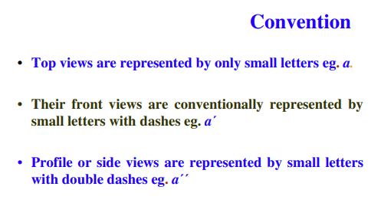
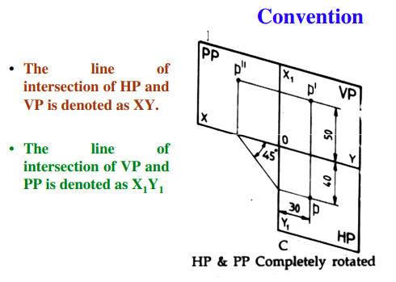
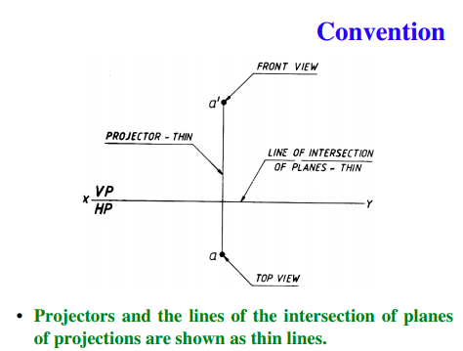

Slide 5
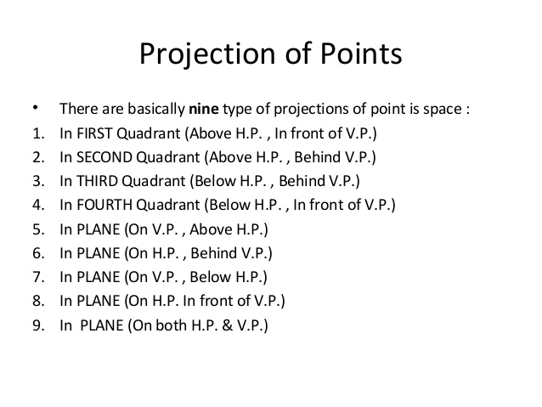
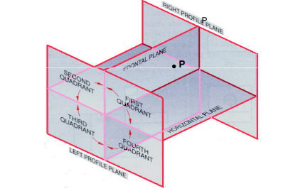

Slide 6
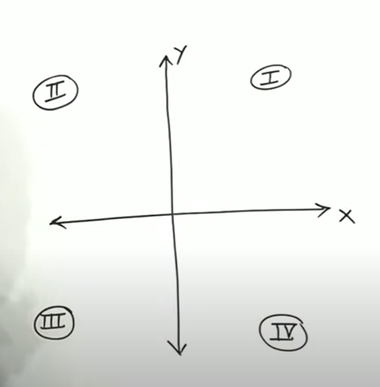
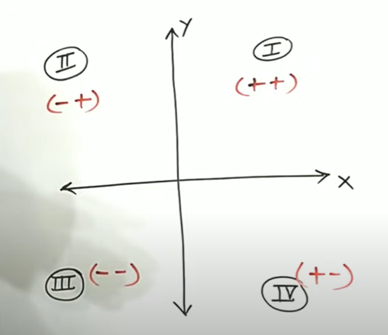
QUADRANTS

Slide 7
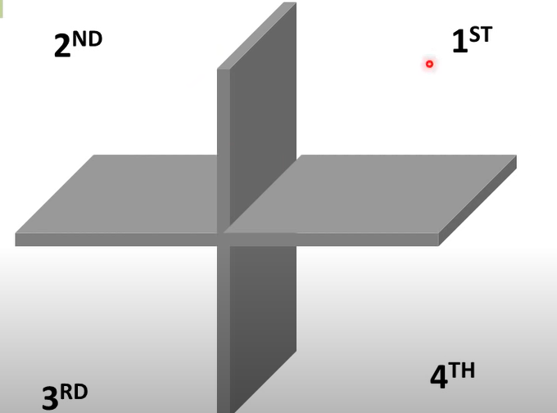
QUADRANTS

Slide 8
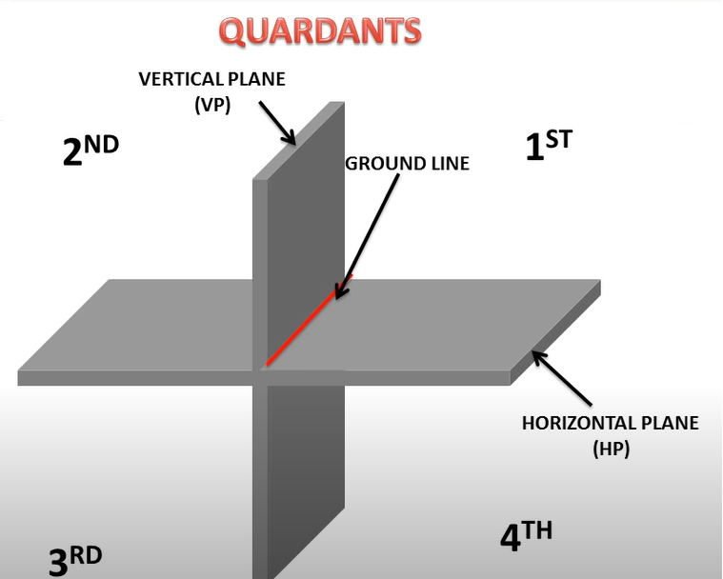
QUADRANTS

Slide 9
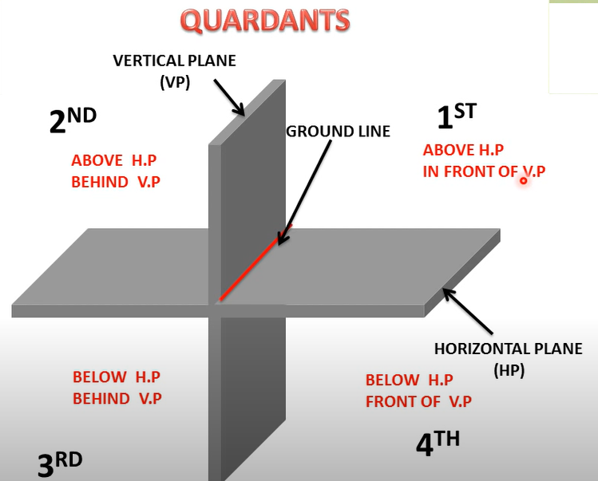
QUADRANTS

Slide 10
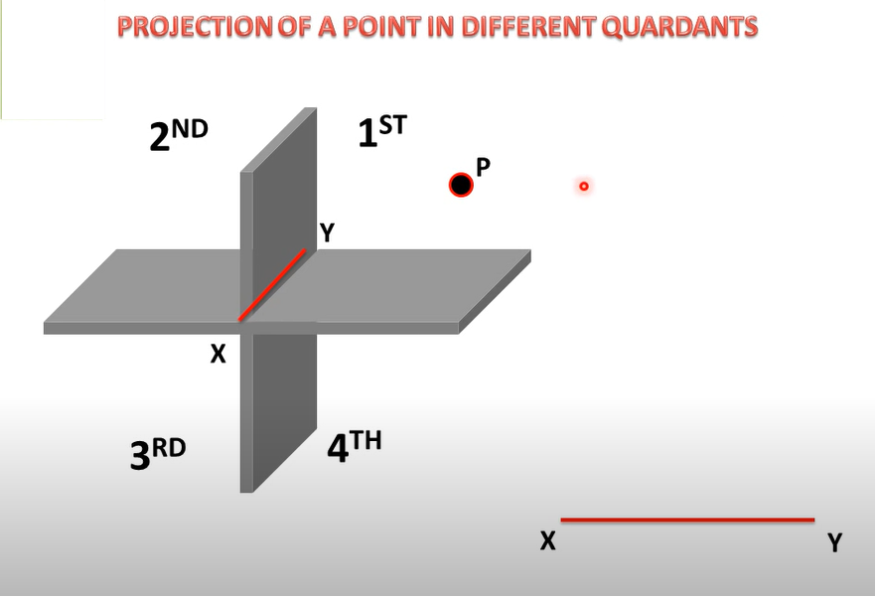
FIRST QUADRANT

Slide 11
FIRST QUADRANT

Slide 12
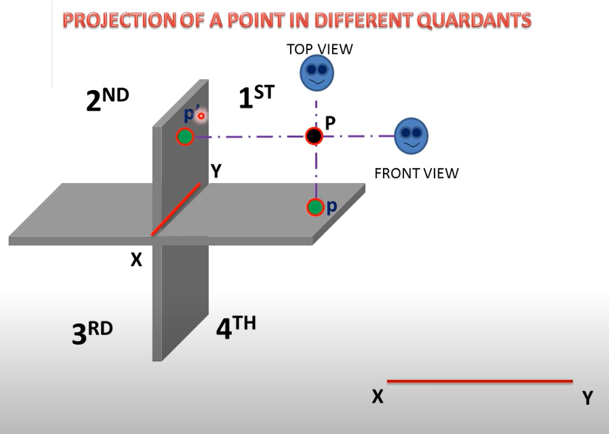
FIRST QUADRANT

Slide 13
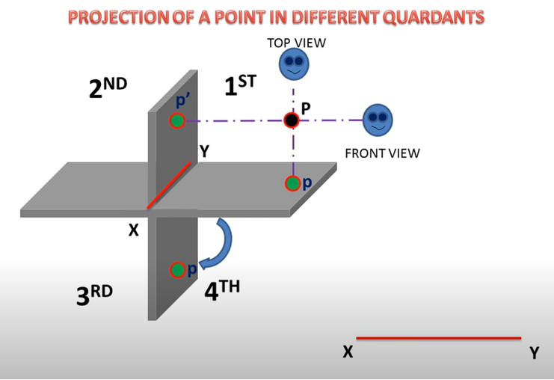
FIRST QUADRANT

Slide 14
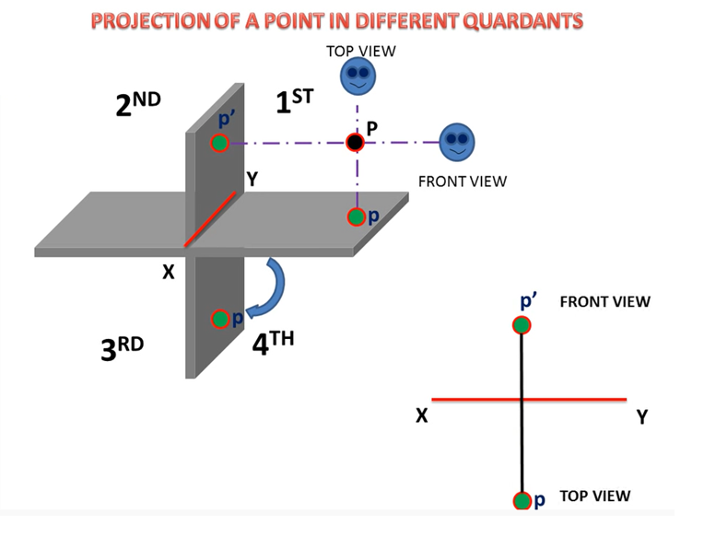
FIRST QUADRANT

Slide 15
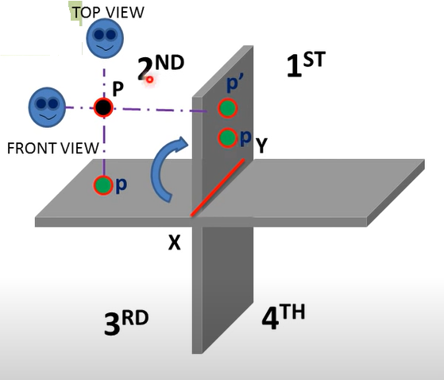
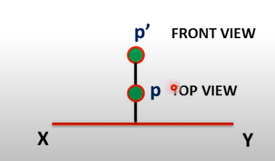
SECOND QUADRANT

Slide 16
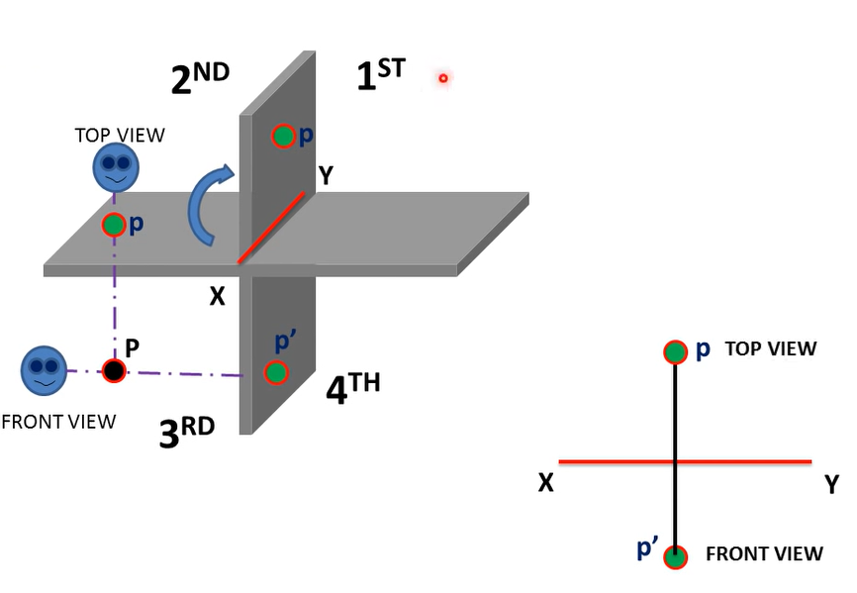
THIRD QUADRANT

Slide 17
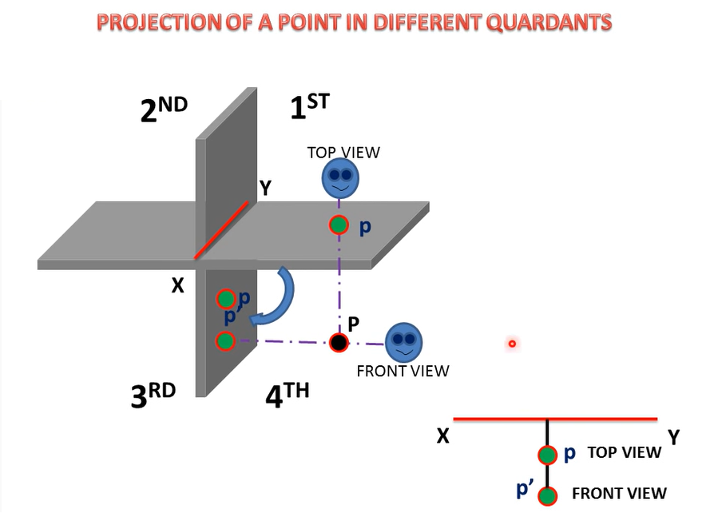
FOURTH QUADRANT

Slide 18
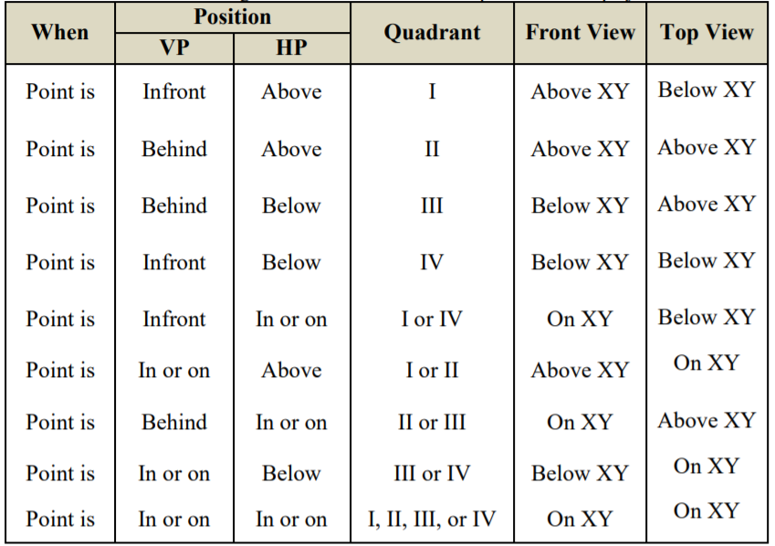
POSITION OF POINTS IN VARIOUS QUADRANTS
Denoted as a’, b’ etc.
Denoted as a, b etc.

Slide 19
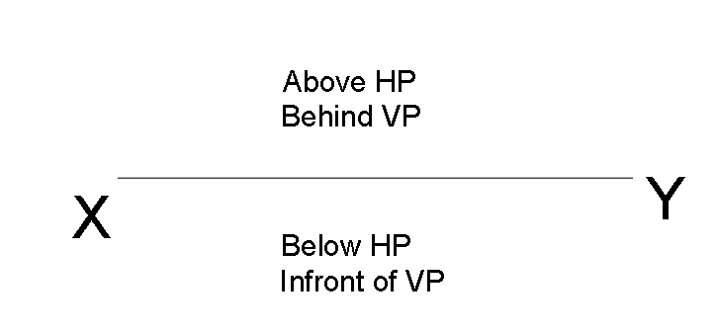
POSITION OF POINTS IN VARIOUS QUADRANTS

Slide 20
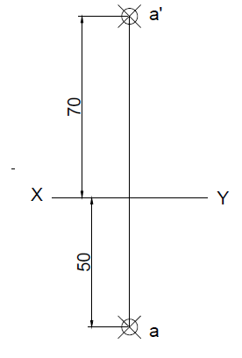
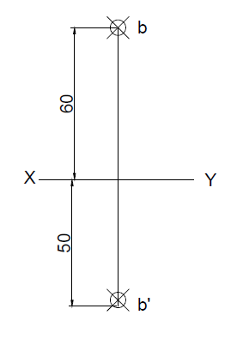
1. 70 mm above HP and 50mm in front of VP
2. 50 mm below HP and 60mm behind VP

Slide 21
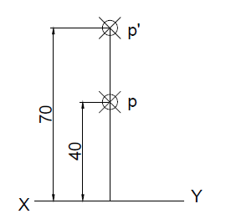
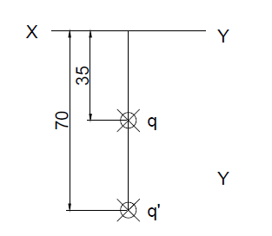
3. 70mm above HP and 40mm behind the VP
4. 70mm below the HP and 35 mm infront of VP.

Slide 22
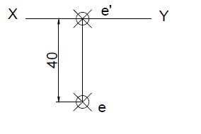
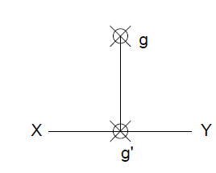
5. On HP and 40mm infront of VP
6. On HP and 40 mm behind the VP

Slide 23
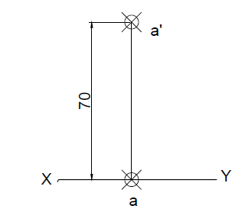
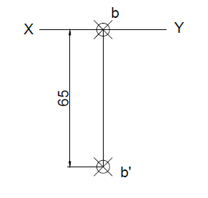
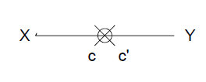
7. Point on VP and 70mm above HP
8. Point on VP and 65mm below HP
9. Point on both HP and VP

Slide 24
10. Draw the projections of the following points on a common reference line keeping the distance between their projectors 40mm apart.
Point A is 50mm above the H.P and 40mm in front of the V.P.
Point B is 60mm above the H.P and 30mm behind the VP.
Point C is 30mm below the HP and 40mm behind the VP.
Point D is 50mm below the HP. and 40mm in front of the VP.
Point D is 50mm in front of the VP and in the HP.

Slide 25
11. Draw the projections of the following points on the same ground line, keeping the projectors 25 mm apart.
i. A is in the H.P. and 20 mm behind the V.P.
ii. B is 40 mm above the H.P. and 25 mm in front of the V.P.
iii. C is in the V.P. and 40 mm above the H.P.
iv. D is 25 mm below the H.P. and 25 mm behind the V.P.
v. E is 15 mm above the H.P. and 50 mm behind the V.P.
vi. F is 40 mm below the H.P. and 25 mm in front of the V.P.
vii. G is in both the H.P. and the V.P.

Slide 26
12. Draw the orthographic projections of the following points.
i. Point P is30 mm . above H.P and 40mm in front of VP.
ii. Point Q is25 mm. Above H.P and 35mm behind VP.
iii. Point R is 32 mm. below H.P and 45mm behind VP.
iv. Point S is 35 mm. below H.P and 42mm in front to VP.
v. Point T is in H.P and 30 mm behind VP.
vi. Point U is in V.P and 40 mm. below HP.
vii. Point V is in V.P and 35 mm. above H.P.
viii. Point W is in H.P and 48 mm. in front of VP.

Slide 27
13. Draw the projections of the following points on the same XY line, keeping convenient distance between each projectors. Name the quadrants in which they lie.
i. Point A is 30 mm above HP and 35 mm in front of VP.
ii. Point B is 35 mm above HP and 40 mm behind VP.
iii. Point C is 40 mm above HP and on VP.
iv. Point D is 35 mm below HP and 30 mm in front of VP.

Slide 28
14. Draw the projections of the following points on the same XY line, keeping convenient distance between each projectors. Name the Quadrants in which they lie.
i. Point E is 30 mm below HP and 25 mm behind VP.
ii. Point F is 35 mm below HP and 30 mm in front of VP.
iii. Point G is on HP and 30 mm in front of VP.
iv. Point H is on HP and 35 mm behind VP.

